Slide 1
We are #1
Sprint Review Project Hope
Notes:
Put a nice graphic here

Slide 2

The Team
Rob O’Connor Artist
Tamara Hooijmans Artist
Humam Abud Allah Artist
Olivier de Haan Designer
Rick Oosthof Designer
Glyn Leine Engineer
Notes:
Put proper roles here

Slide 3
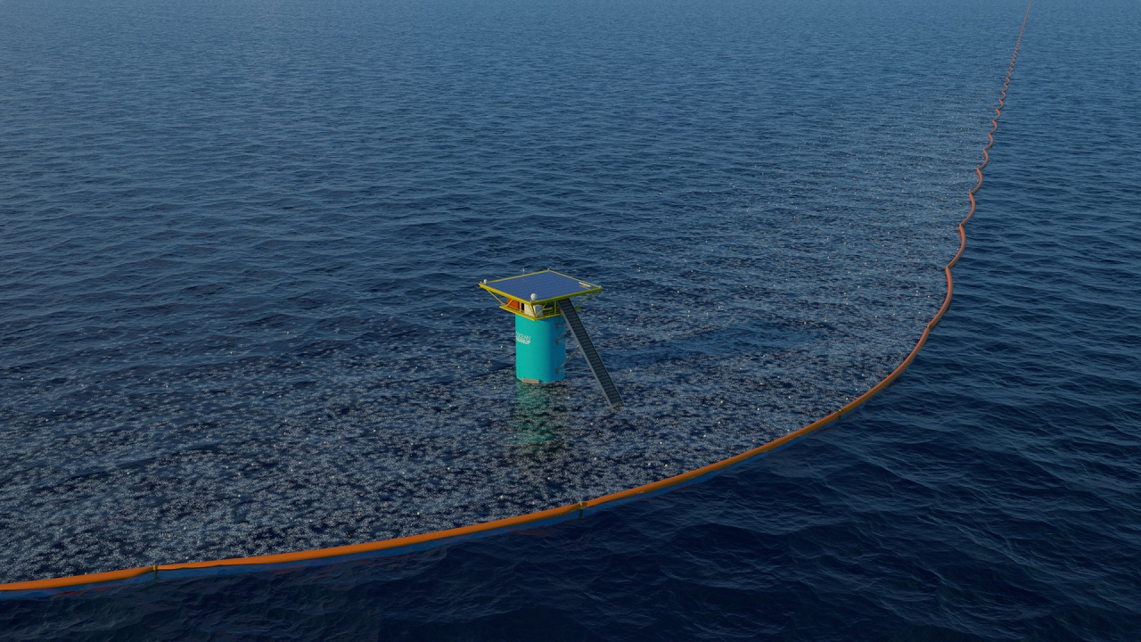

Notes:
Ocean cleanup is a Rotterdam based organization dedicated to cleaning up the great garbage patches, currently deploying in the biggest and most researched one: the north atlantic patch

Slide 4
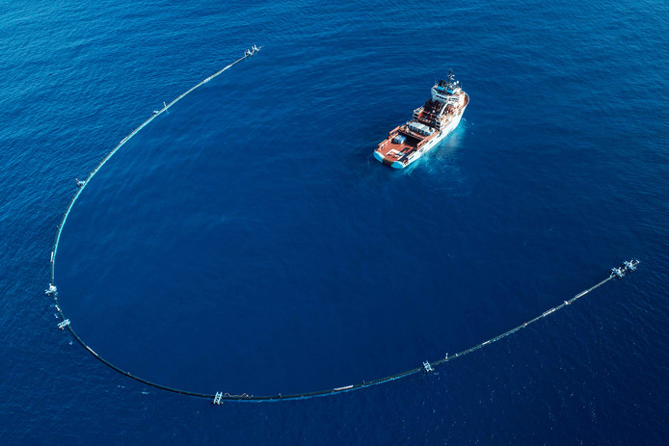
Research
Notes:
Ocean cleanup/message of hope/informing new audiences is important

Slide 5
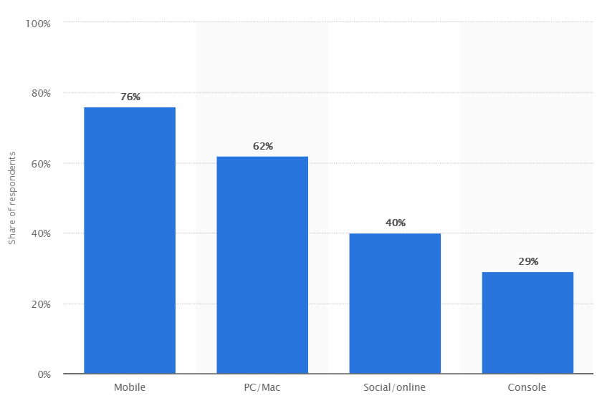
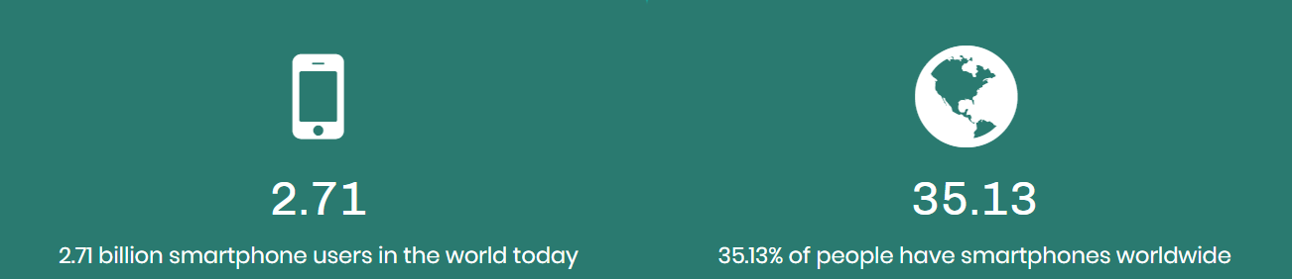
Notes:
Biggest audience in the world for a unity3d product is mobile games

Slide 6
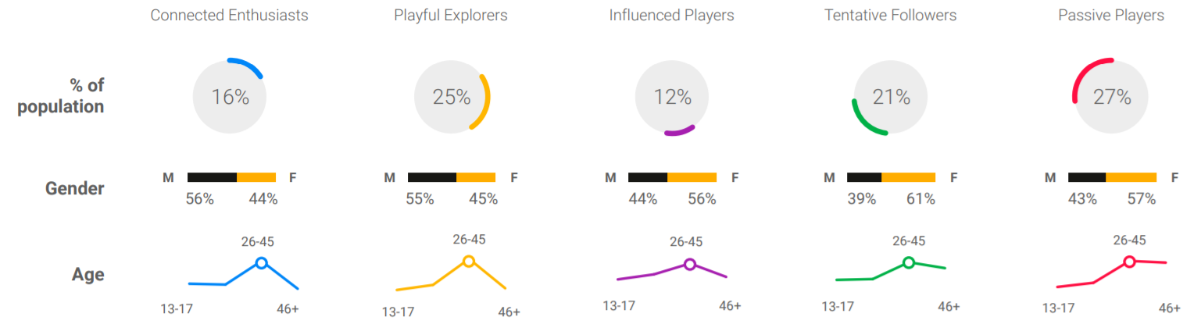
Notes:
5 types in total

Slide 7
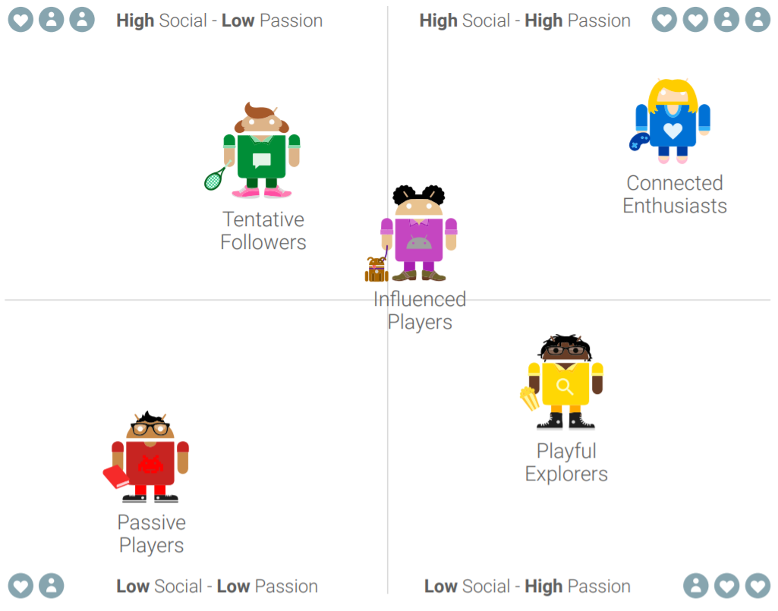
Notes:
High passion so most likely to try our game = connected enthusiasts & playful explorers

Slide 8
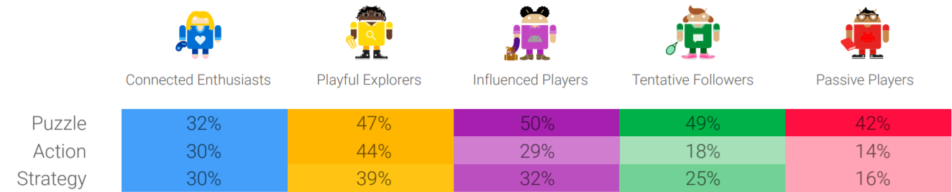
Notes:
Aka we had 3 choices of game type, now puzzle was the biggest by far but we decided to brainstorm a few game ideas that we liked and thought were fun and action seemed like the most fun

Slide 9





Organization
Notes:
Show how good we are at planning

Slide 10
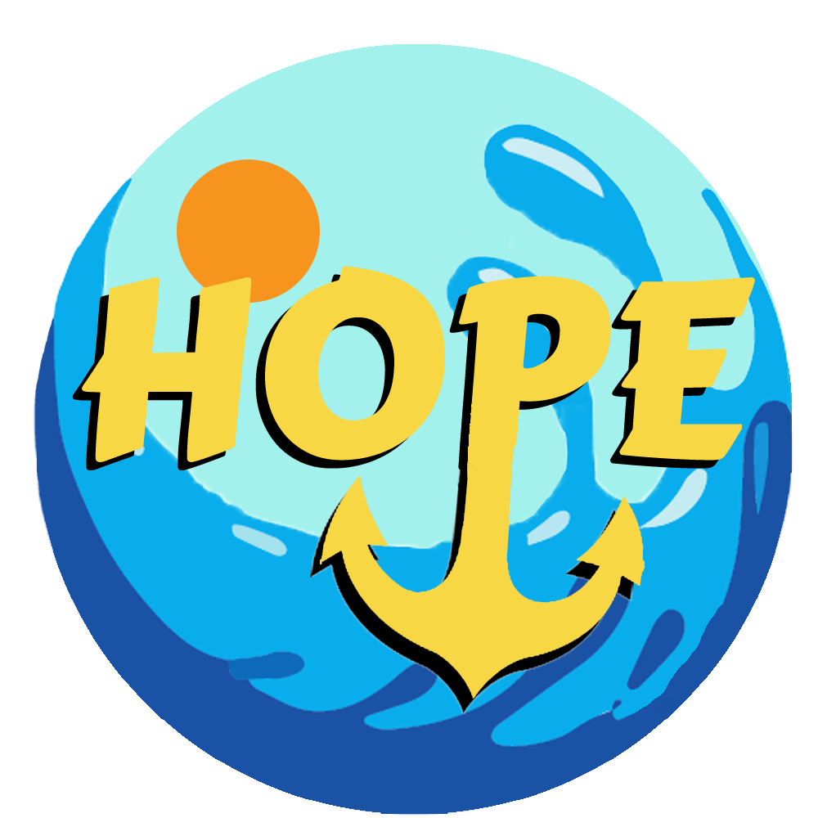
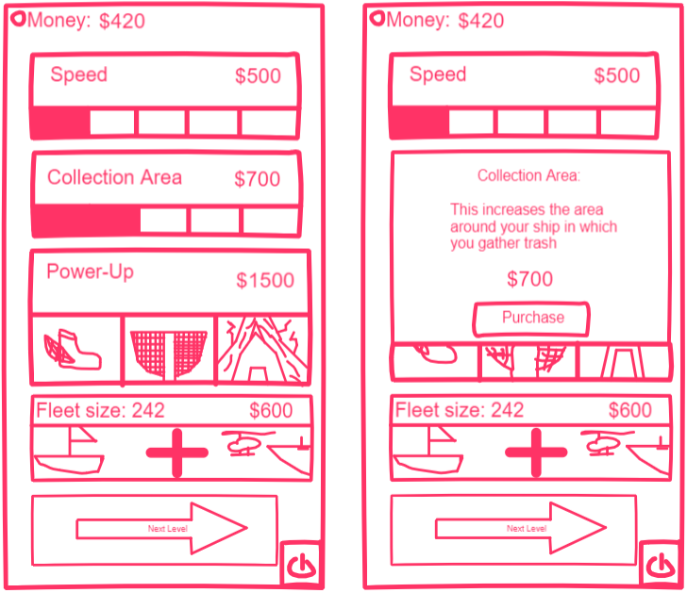
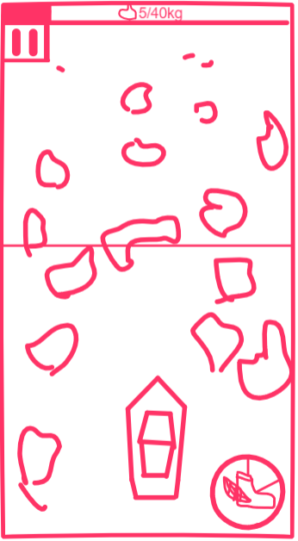
The Game
Notes:
You just lost it

Slide 11
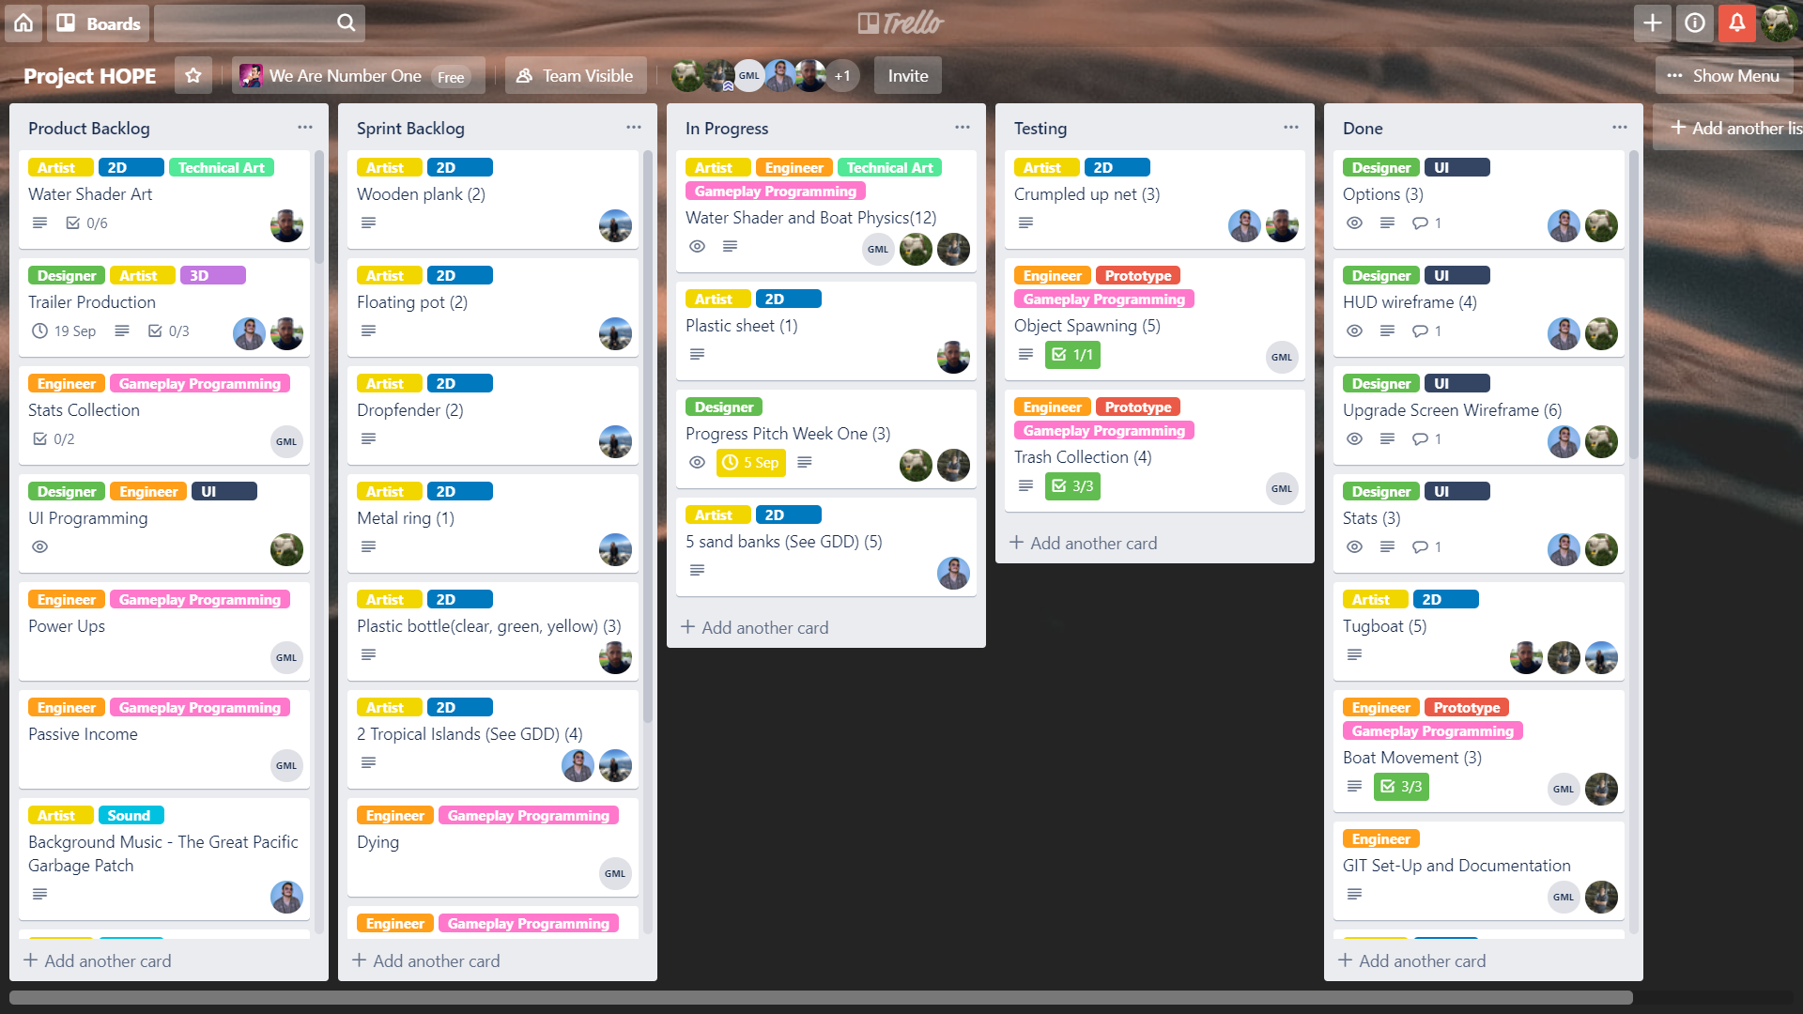

Slide 13


Documents
GDD
Research
Trello
Git

Slide 14



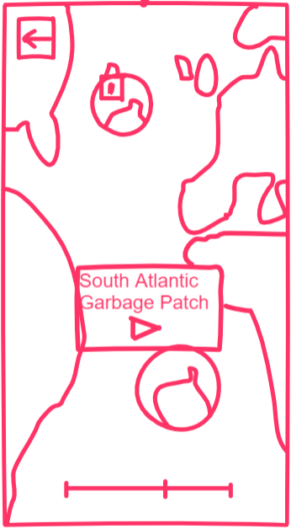
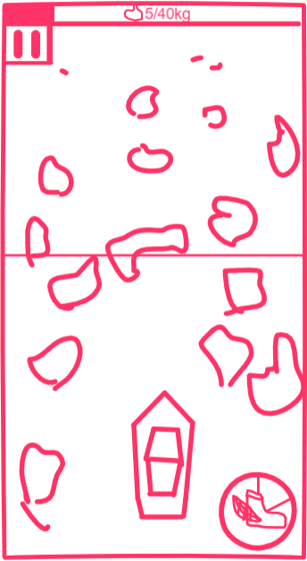
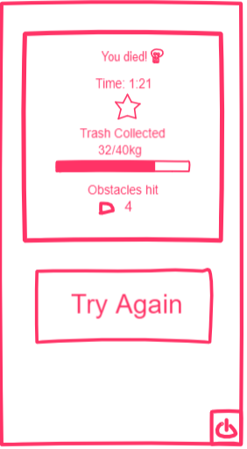
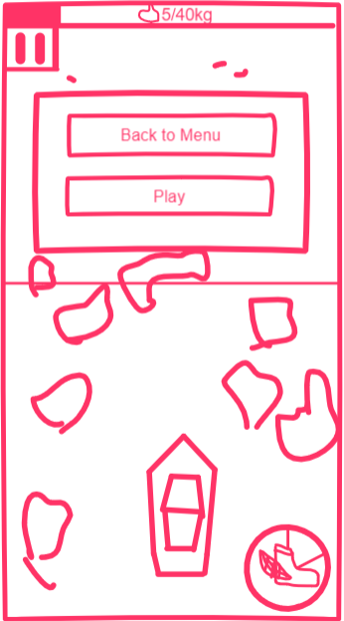
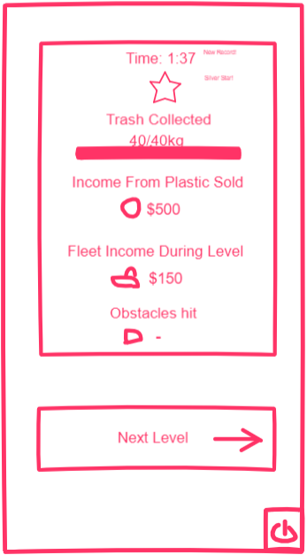
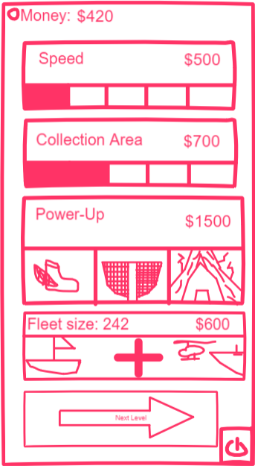
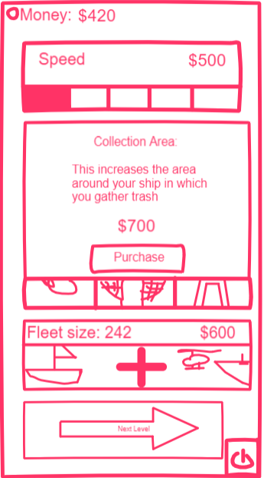
Notes:
Temp dia for wireframes

Slide 15
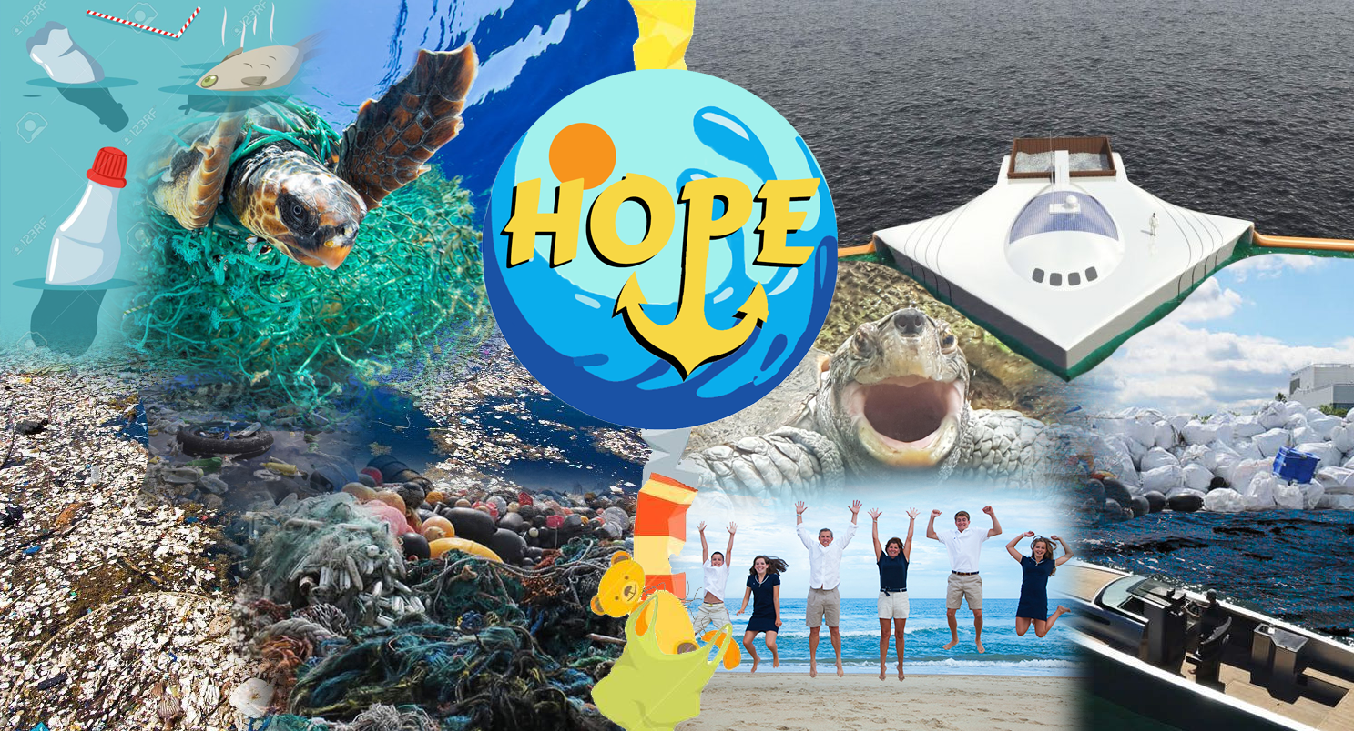
Notes:
moodboard

Slide 16
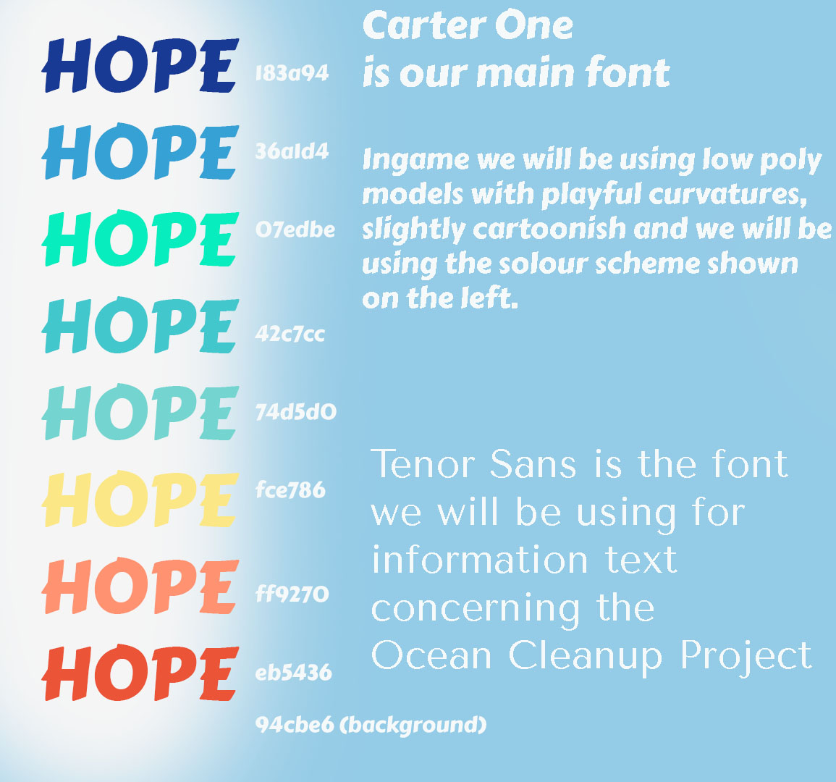
Notes:
Whats our style

Slide 17
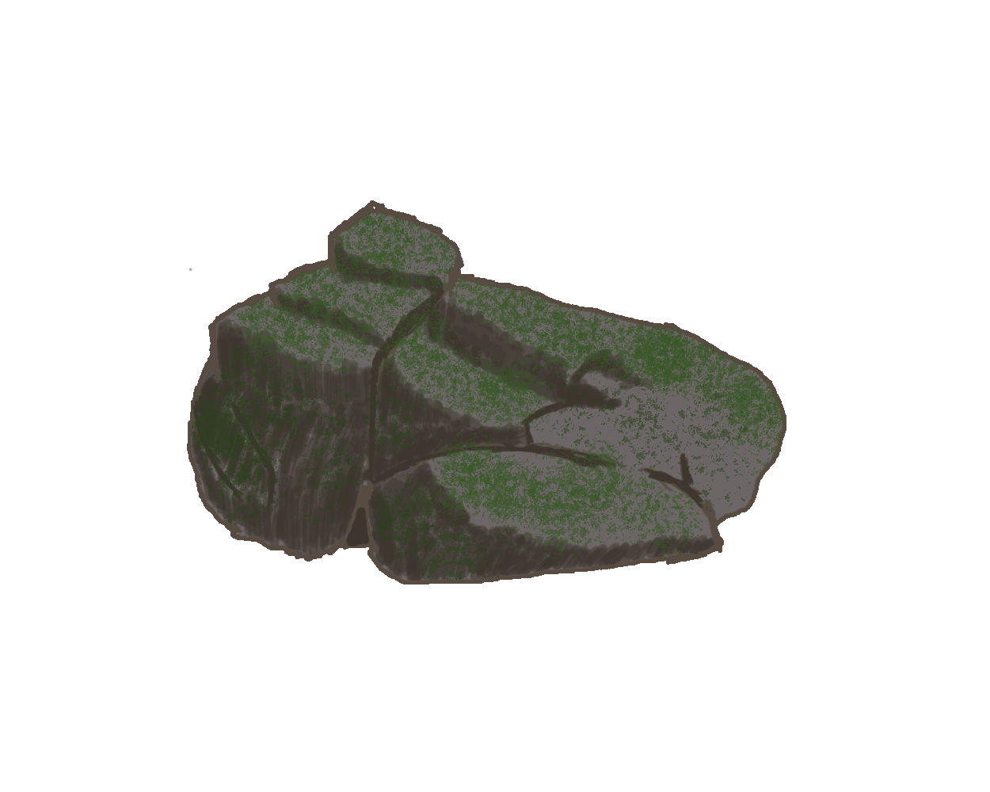
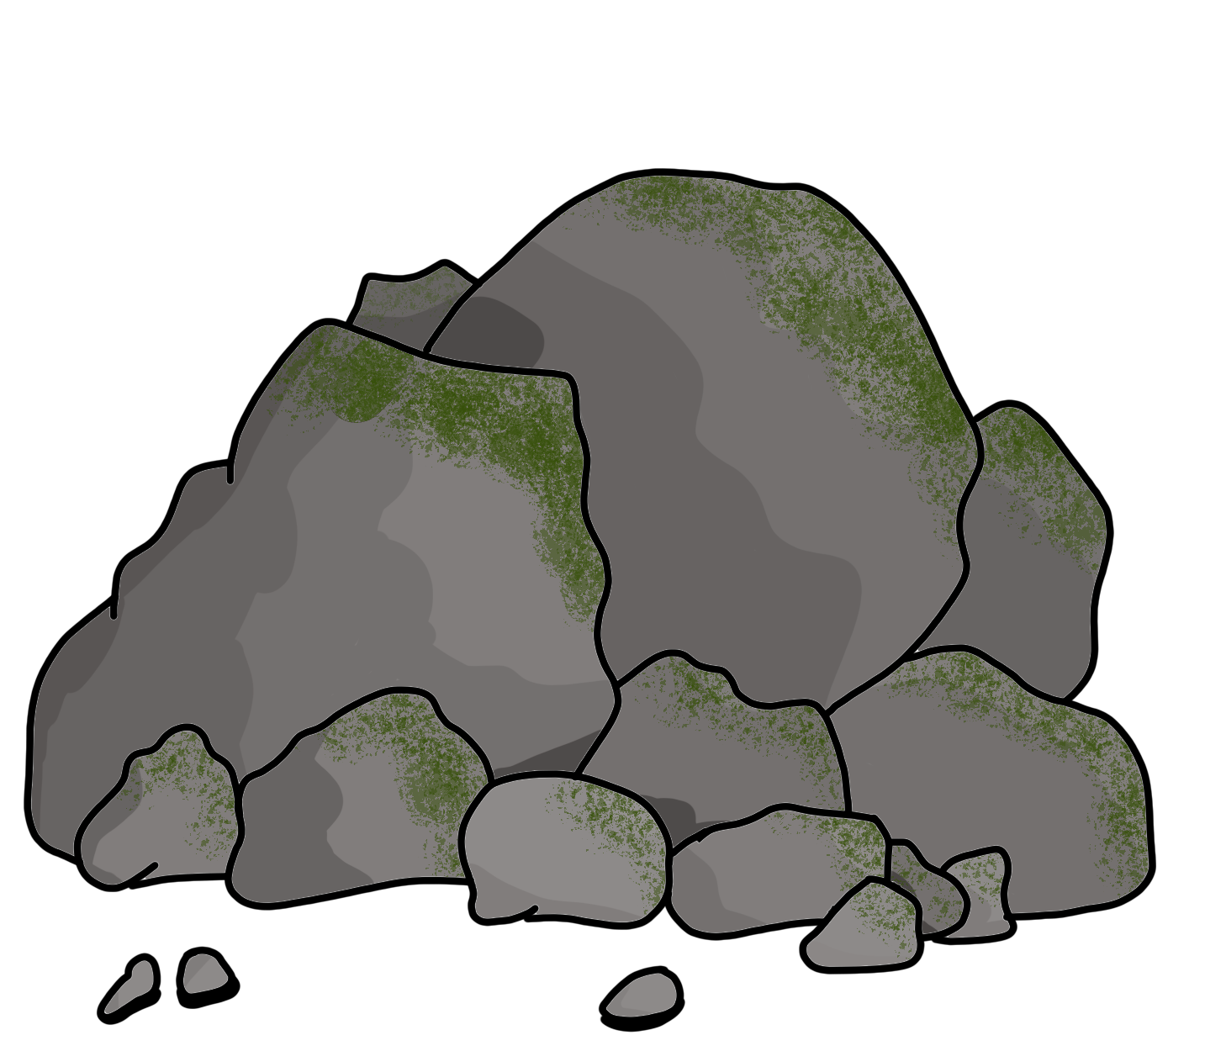
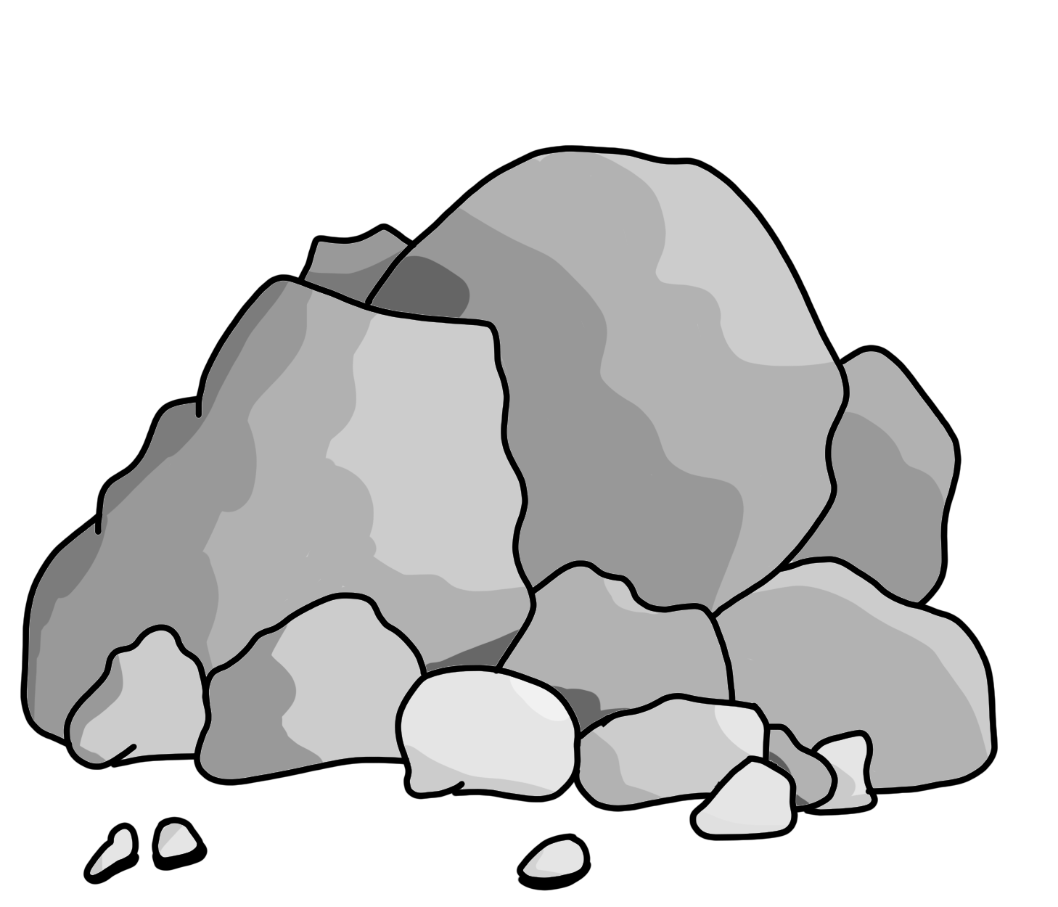
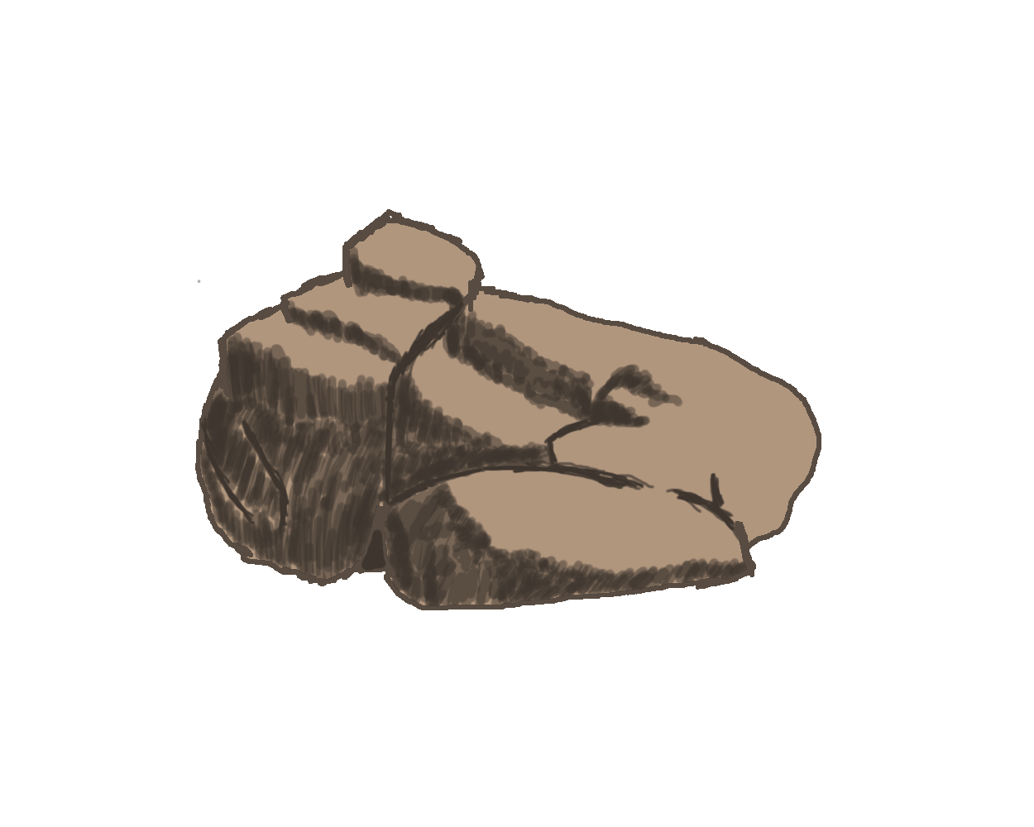
Notes:
Rock concept art

Slide 18
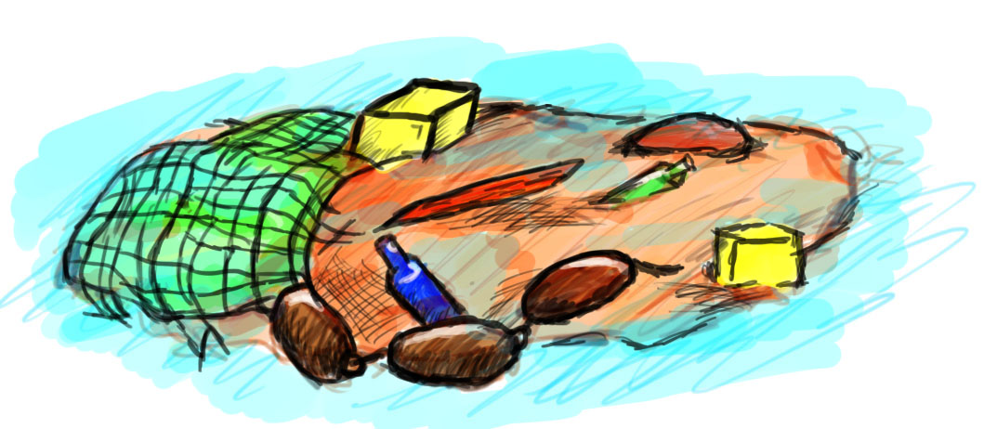
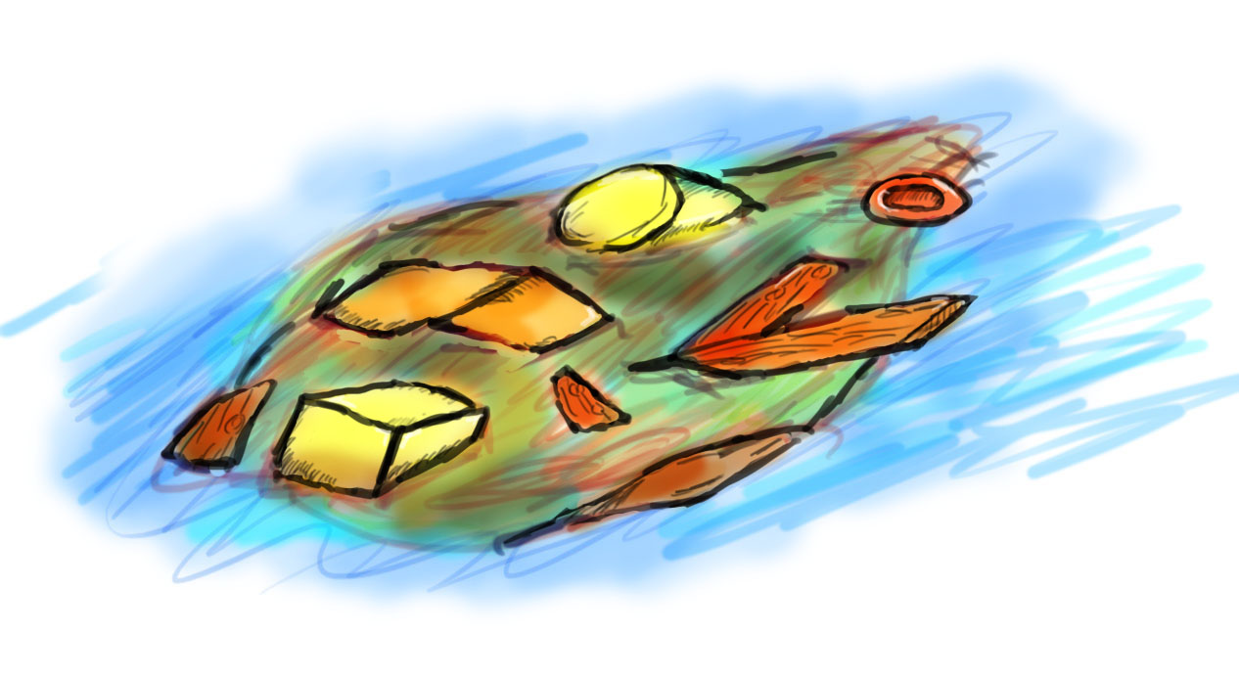
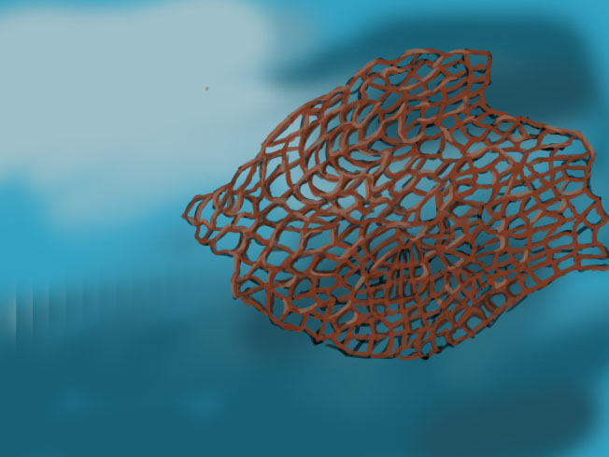
More art concepts
Notes:
Boat concept art

Slide 19
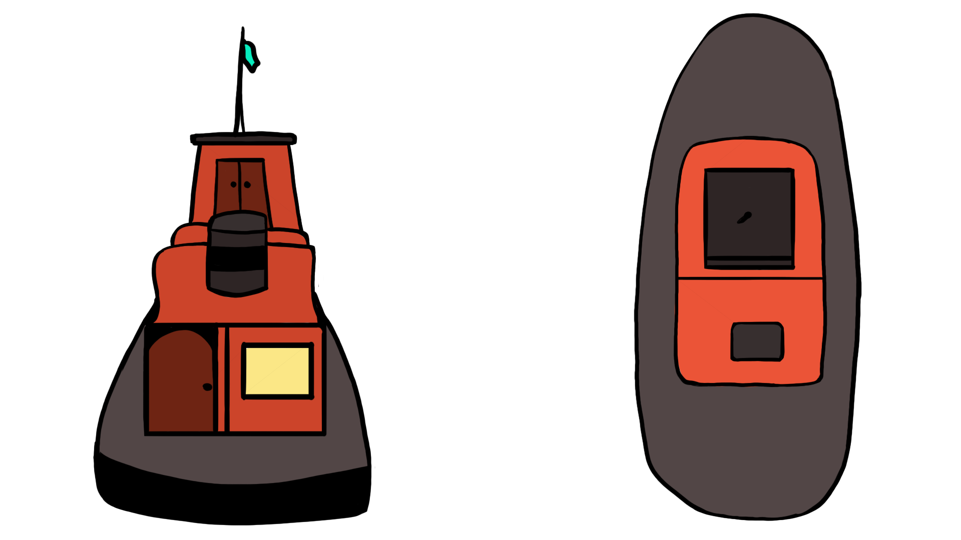
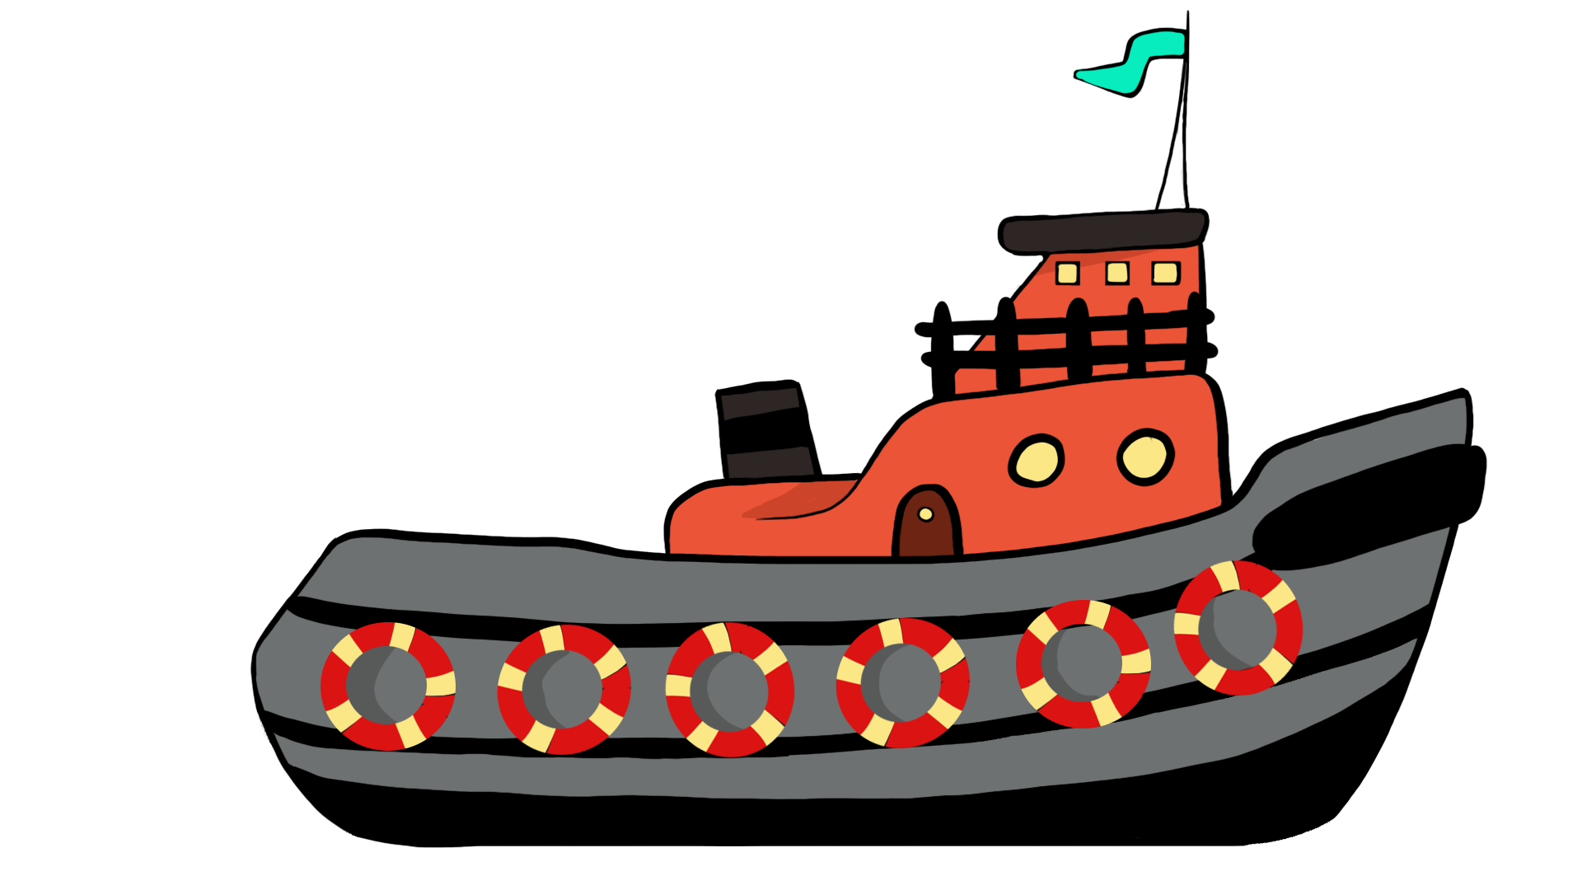
Notes:
Tugboat

Slide 20
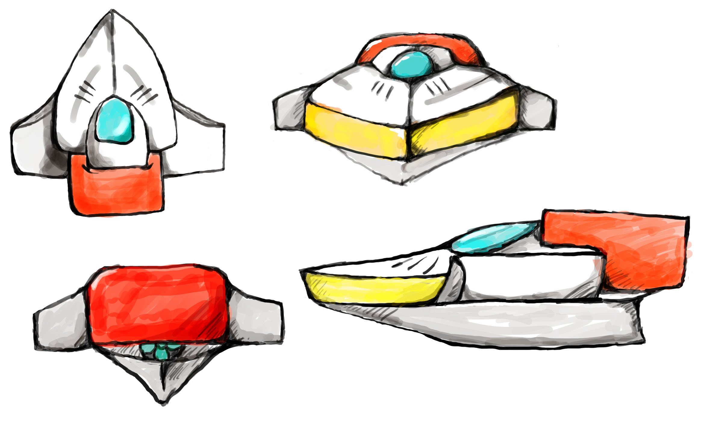

Slide 21
More concept art

Slide 22
Storyboard/Script

Slide 23
Demo slide(gif/video?)
This is also then what glyn did this week
Notes:
Boat shoots trash

Slide 24
Next week
Next week we want to have an unpolished version of the game
Start Trailer Production
Gameplay: Levels, Death, Powerup, Upgrading, UI
Further Prototyping & Testing
Audio Production
3D Models
2D Art
Notes:
Next week sprint backlog, what are we planning on doing next week?(nice quick fire list)

Slide 25
Thank you for listening

